Slide 1
McDonald's UI/UX Redesign

Slide 2
Introduction
Good morning everyone. Today, I will present a UI / UX redesign for the McDonald's Egypt website. My primary goal was to enhance the user experience by solving usability issues found in the four core sections: Home, Eat, Learn, and Family. I focused on making navigation smoother and the interface more intuitive.

Slide 3
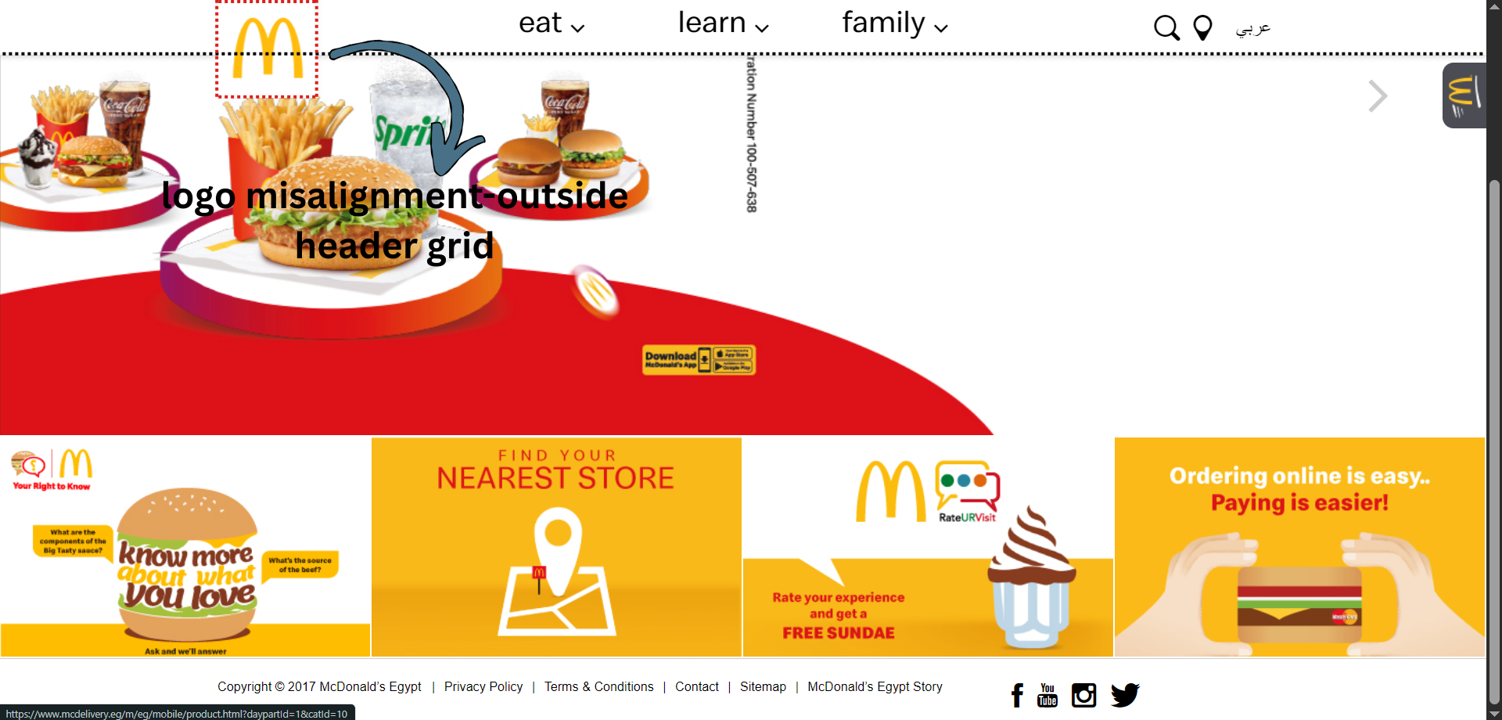
The home page ui/ux problems “Header issues”
1-Logo Misalignment & Layout Shift: The logo is floating outside the grid boundary, causing visual imbalance and breaking the alignment with other header elements.

Slide 4
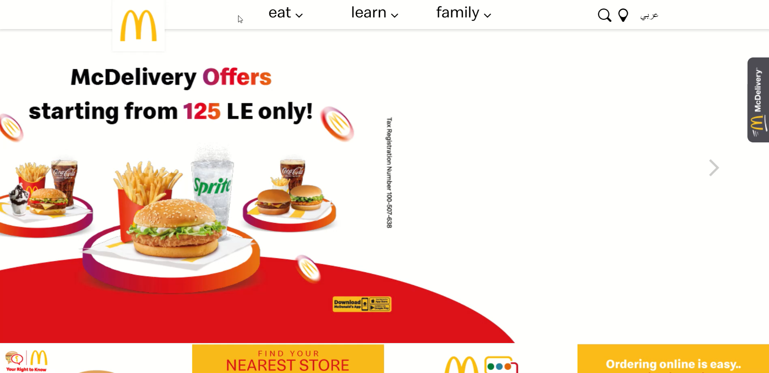
The home page ui/ux problems “Header issues”
2-Overwhelming Mega-Menus on Hover: Nav-links trigger cluttered mega-menus on hover, increasing Cognitive Load for the user. It’s bad UX to force all options at once instead of categorizing them on dedicated landing pages.

Slide 5

The home page ui/ux problems “Header issues”
3- Poor Search Experience (Usability Issue): The search function is hidden or outdated, lacking a proper input field, which reduces accessibility for users trying to find specific items quickly.
4- Missing Primary CTA (Log In): There is no clear "Log In" or "Sign Up" button, which is a critical element for user retention and loyalty programs.

Slide 6
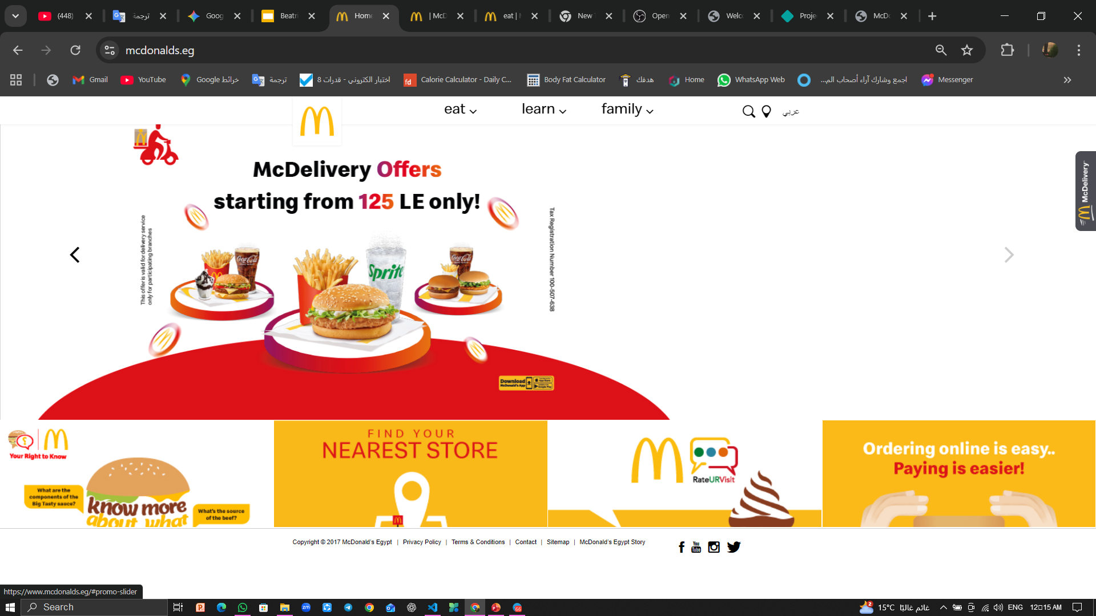
The home page ui/ux problems “Body & footer issues”
1- Broken Slider & Usability: The image slider is non-functional and unresponsive, creating a frustrating experience. It forces users to view static, cut-off content.
2- Poor Use of White Space (Negative Space): Excessive and random white spaces make the layout feel disconnected and "empty" rather than "clean," destroying the visual flow.
3- Poor CTA Placement & Discoverability: The delivery button lacks visual weight and is positioned outside the user's primary scanning path (F-Pattern), which drastically lowers its discoverability and hinders the conversion flow.
4- The footer is not divided and all the links are next to each other.

Slide 7
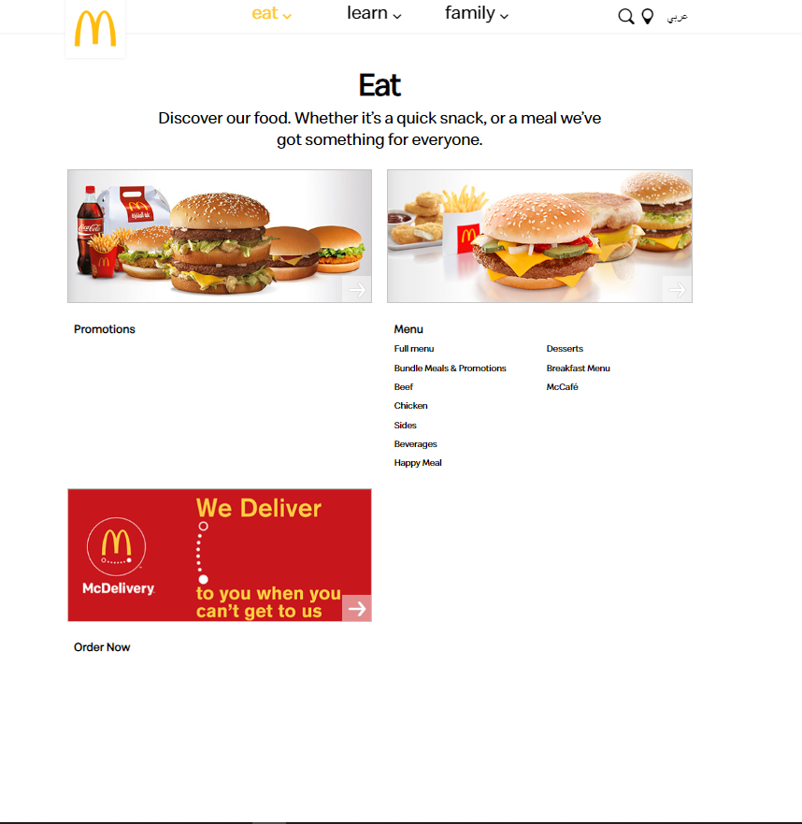
The Eat page ui/ux problems
1- Lack of Contextual Header (Weak Visual Engagement):The section heading ("Eat") is floating as plain text without any supporting imagery.
2- Flat Layout & Lack of Containment (No Depth):The content areas (Menu & Promotions) lack defined borders or Drop Shadows. This "Flat Design" makes elements blend into the white background, causing a loss of focus. The user can't distinguish where one section ends and the other begins.
3- Poor Affordance on Links (Bad Hover Effects):The text links have weak Visual Affordance. The hover effects are practically non-existent or visually unappealing
4- Weak CTA Prominence (Banner Blindness):The "McDelivery" box looks like a static advertisement banner rather than a functional tool. It lacks Visual Weight and doesn't stand out as the primary action, potentially suffering from Banner Blindness.

Slide 8
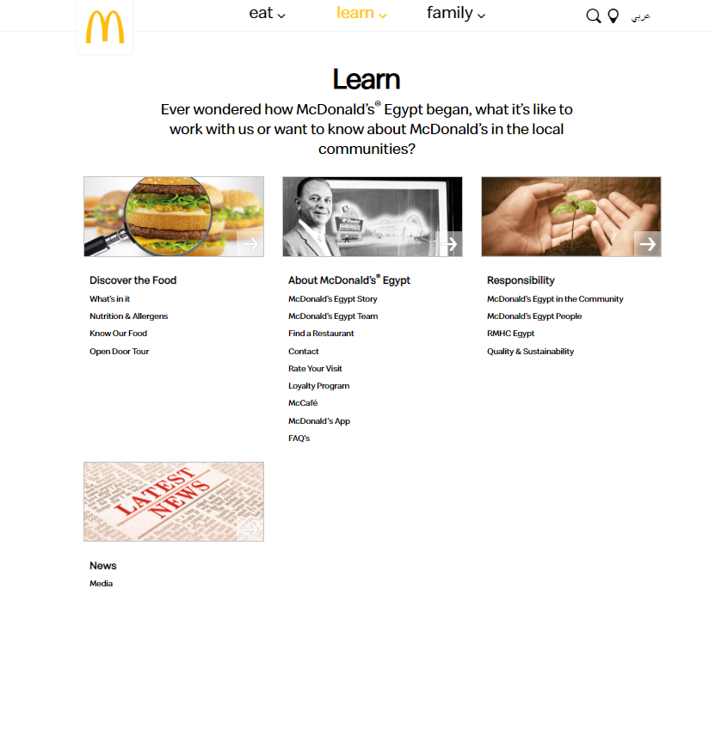
The Learn page ui/ux problems
1- Lack of Contextual Header (Weak Visual Engagement):The section heading ("Eat") is floating as plain text without any supporting imagery. It fails to create an "Atmosphere" or set the mood for the dining experience, making the interface feel dry and purely functional.
2- Flat Layout & Lack of Containment (No Depth):The content areas (Menu & Promotions) lack defined borders or Drop Shadows. This "Flat Design" makes elements blend into the white background, causing a loss of focus. The user can't distinguish where one section ends and the other begins.
3- Poor Affordance on Links (Bad Hover Effects):The text links have weak Visual Affordance. The hover effects are practically non-existent or visually unappealing

Slide 9
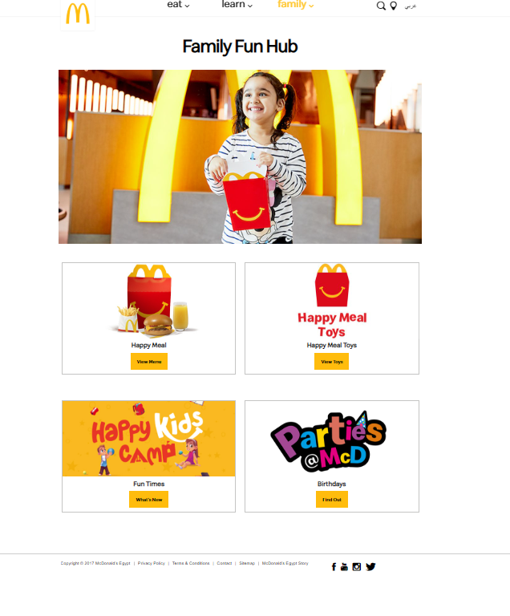
The Family page ui/ux problems
1- Outdated Box Model (Visual Noise):The cards rely on harsh, visible borders to define boundaries. This creates unnecessary Visual Noise and makes the interface look like an outdated wireframe or a basic HTML table rather than a modern interface.
2-Disconnected Header Context:The heading "Family Fun Hub" is placed outside the visual context, sitting plainly above the image. This separation breaks the Gestalt Law of Common Region, making the title feel detached from the emotional imagery of the child.

Slide 10
Click to view the new design

